Slide 1
JOINS, SUBQUERIES, CTEs & WINDOW FUNCTIONS
Ian Mbaya

Slide 2
TYPES OF JOINS
INNER JOINS – returns records that have matching values in both tables.
LEFT JOIN – returns all rows from the left table and the matched from the right. NULLs are returned if no match exists.
RIGHT JOIN – opposite of the left join
FULL JOIN – returns all rows from the left and right table whether there is a match not.
CROSS JOIN/CARTESIAN PRODUCT – Each row in the left is combined with all the rows from the second table.
SELF JOIN – join a table with itself.
Notes:
Full Join – comparison
Cartesian Joins – Find all possible combinations
Self-join - Compares rows within the same table, i.e. when identifying a hierarchy within the data

Slide 3
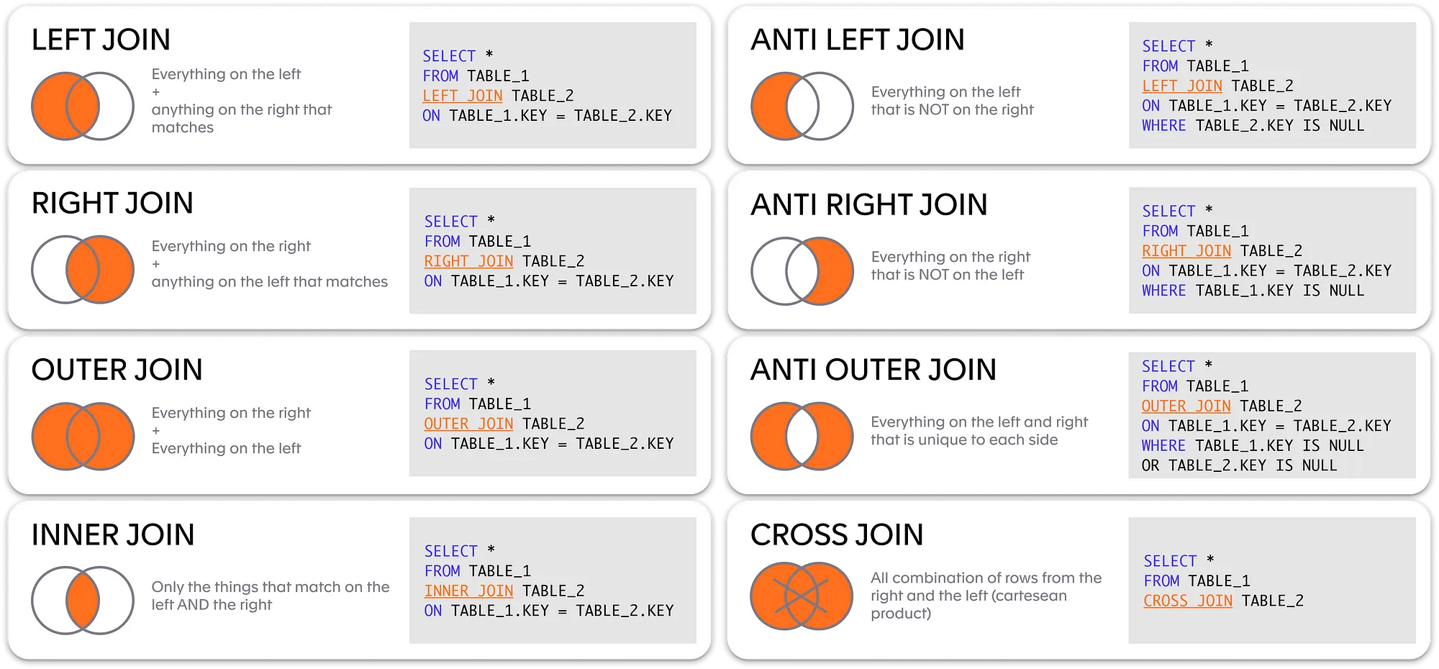

Slide 4
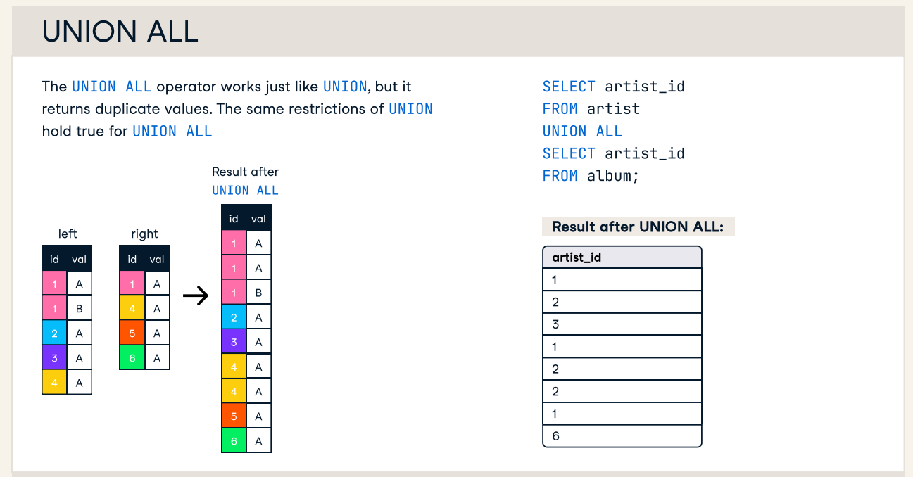
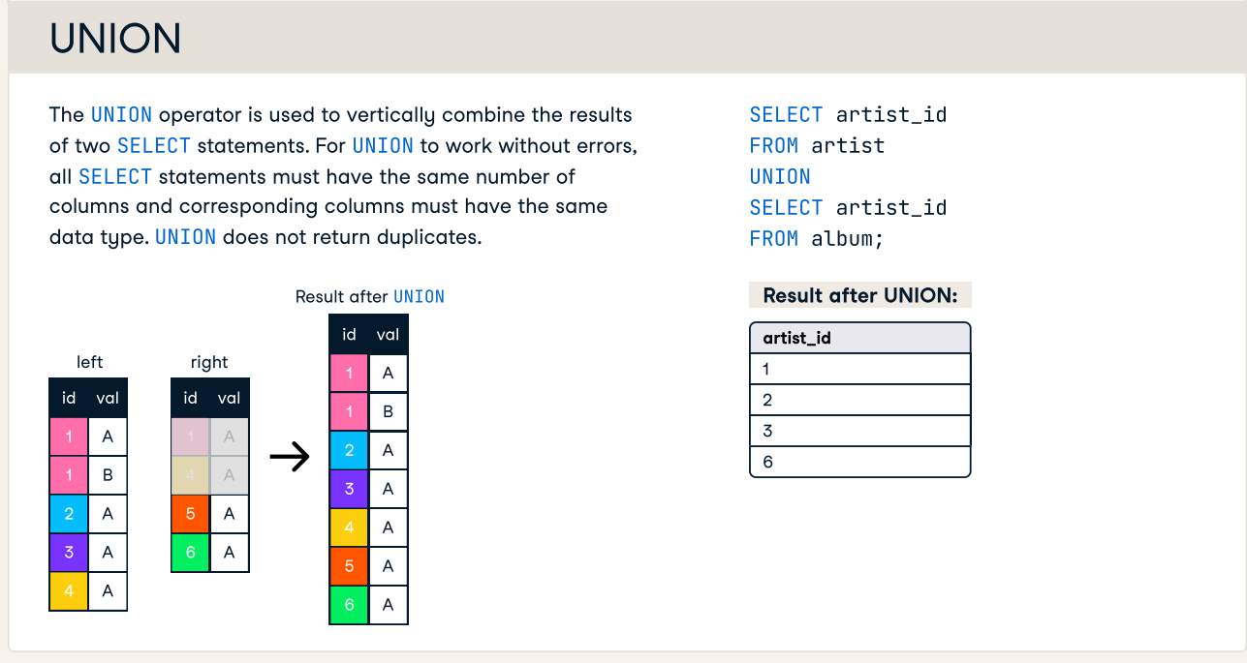

Slide 5
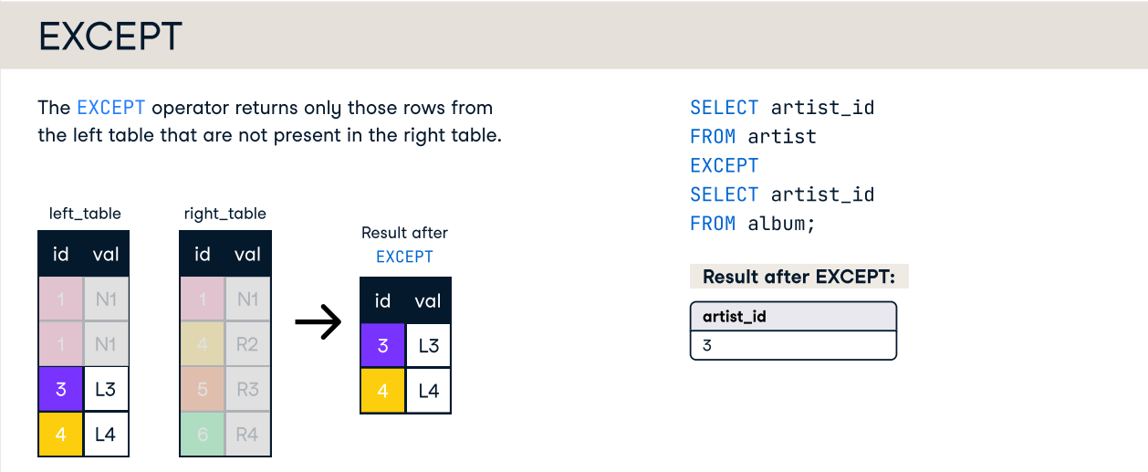
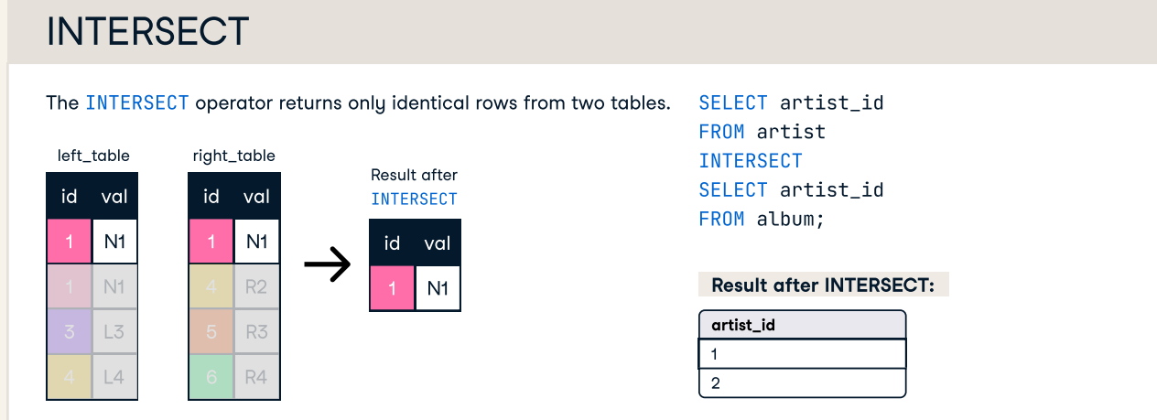

Slide 6
SUBQUERIES
*A query that is nested within another query.
Subqueries can be used within SELECT, FROM, WHERE, DELETE, HAVING, INSERT, and UPDATE statements there are used to:
Add a new column to the main query result.
Creating a filter.
Creating a consolidated source for selecting data.
Check for existence.
Compare related data.
Simplifying complex queries.
Avoiding repetition

Slide 7
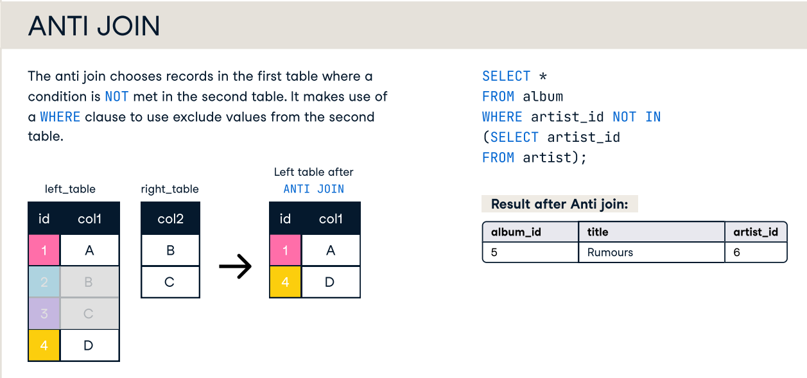
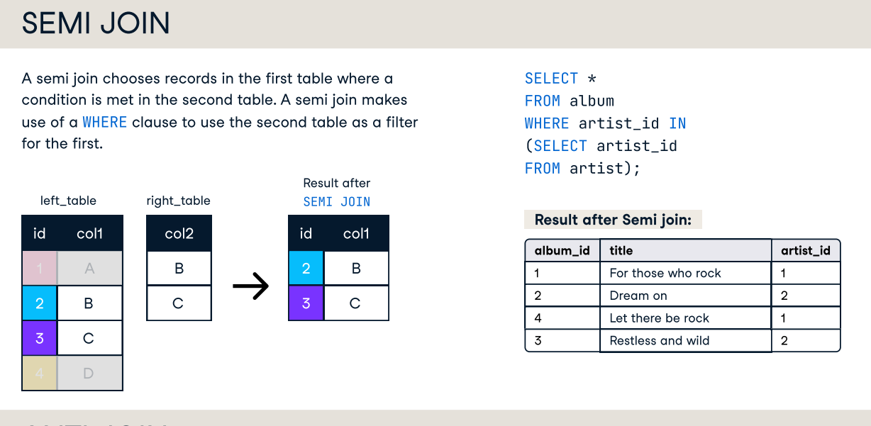

Slide 8
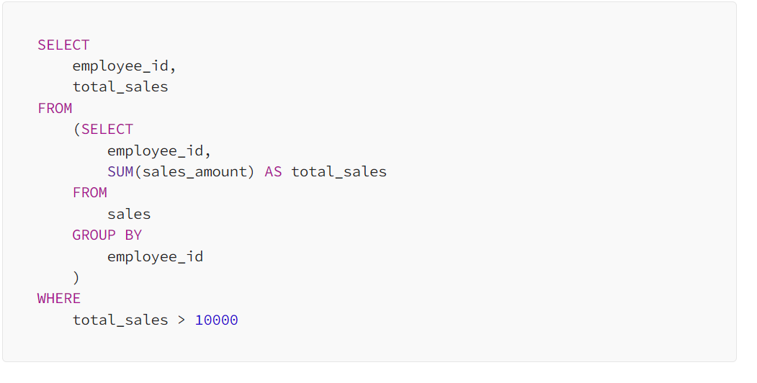
Another Example of subquery

Slide 9
Common Table Expressions
Temporary result set, used to simplify complex queries.
Defined using WITH before the main query.
Enhances readability and reusability.
Recursive CTEs handle hierarchical data.

Slide 10
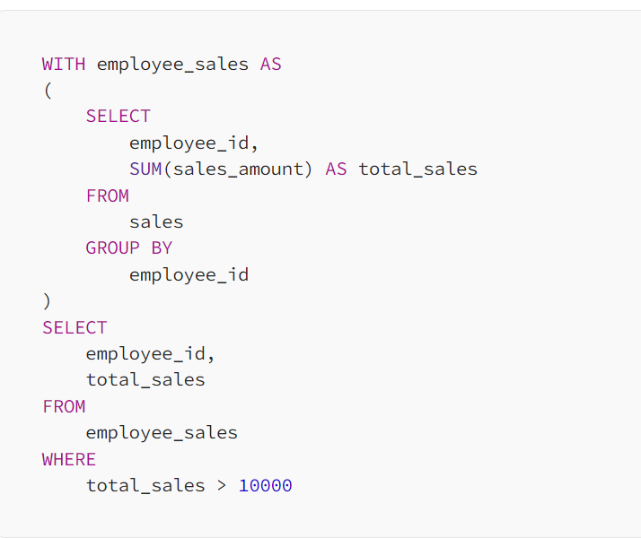
CTE - Example

Slide 11
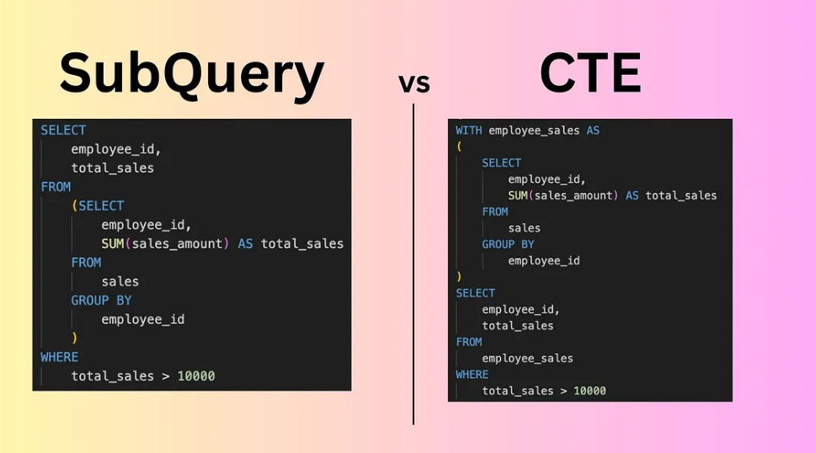

Slide 12

Window functions?
SQL features that allow you to perform calculations across a set of rows that are related to the current row, without collapsing the result set into a single output row.
Window functions compute their result based on a sliding window frame, a set of rows that are somehow related to the current row.

Slide 13
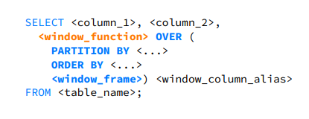
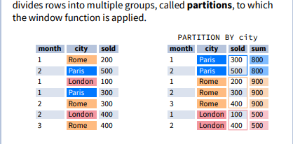
Windows Function - Syntax
You must define a window_function and OVER () for the function to be applied across columns.
PARTITION BY, ORDERBY and window frame are all optional.
<window_frame> defines bounds
Notes:
UNBOUNDED PRECEDING Includes all rows before the current row.
n PRECEDING Includes rows within n rows before the current row.
CURRENT ROW Refers only to the current row.
n FOLLOWING Includes rows within n rows after the current row.
UNBOUNDED FOLLOWING -Includes all rows after the current row.
These bounds define how much data is included in calculations for each row within a window frame, allowing for flexibility in aggregations like running totals or moving averages.

Slide 14
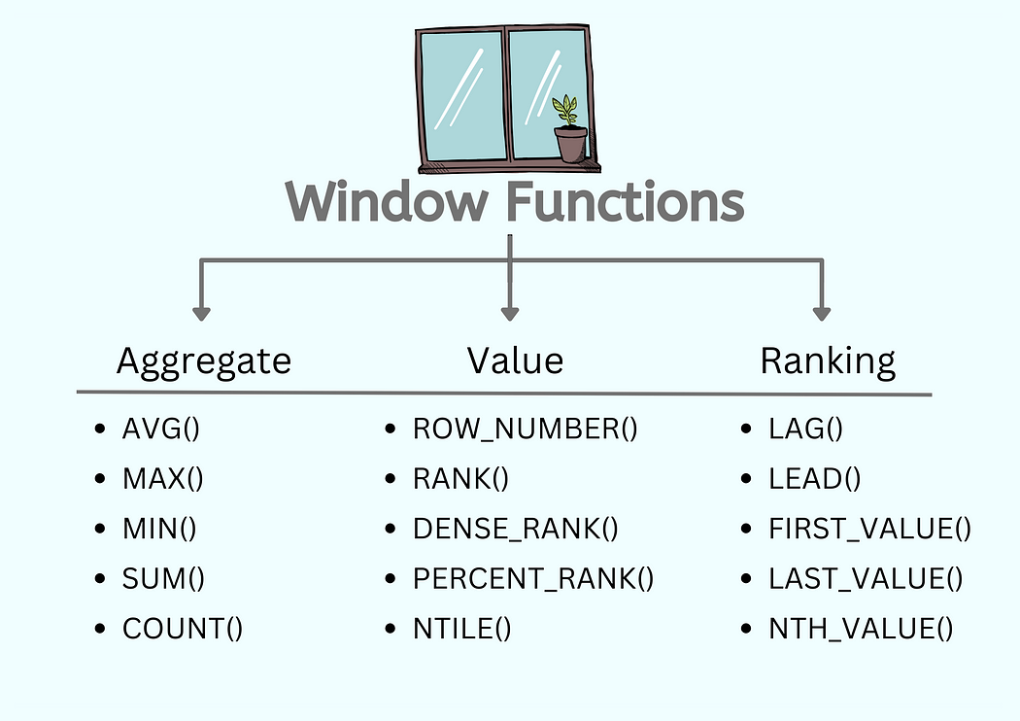

Slide 15
